Slide 1


SA: RNA World
Plant Cell Organelles
Goal:
Goal:
Questions: Notes:
Personal Reflection:
008
009

Slide 2
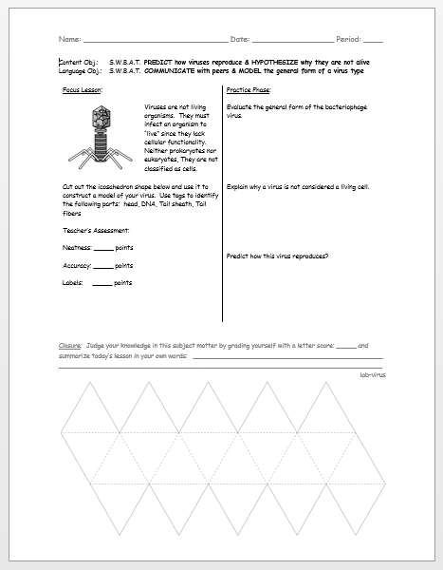
Checkpoint: Homework Virus Models
Good Job!
Be sure you’ve completed the questions and your reflection summary.

Slide 3
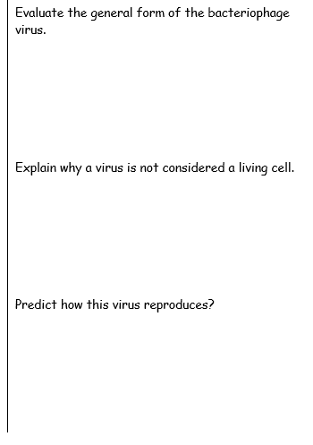
Homework Virus Models
Regular icoscahedron head
DNA present within head
Tail sheath for injection site
Tail fibers for cell binding
Examine the 9 characteristics of living things … (we will do this today as a class with our first checkpoint objective).
Lytic infections allow the virus to reproduce by using the cells machinery.
Lysogenic infections allow the virus to incorporate into the host genome!

Slide 4


Table of Contents: Be sure to match your table of contents so that we all work together as a class.
Pg. | Left Side Items |  | Pg. | Right Side Items
BI |  |  | BI
000 | Mother Earth |  | 001 | Characteristics of Life
002 | LAB: Evaluating Microscopes |  | 003 | LAB: Microscope of Letter “e”
004 | SA: Multiple Origins of Life |  | 005 | Levels of Organization
006 | Viral Reproduction Mechanisms |  | 007 | VN: Virus Life & Evolution
008 | SA: RNA World |  | 009 | Plant Organelles

Slide 5


Week 03 Tuesday Goal: By the end of the lesson, students will be able to … identify the structure and function of all plant organelles.
Research Question:
4D. How do the functions of computer parts correspond the functions of certain cell parts?

Slide 6
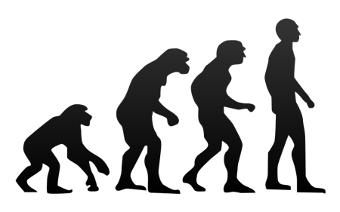
Right Side Notes
In the 4.5 billion year history of Earth, we have discovered patterns often provide evidence for evolutionary change.
.
.
1F. What is the evidence for change?
2F. What are some of the pattern of change?
3C. Is there evidence that all life follows a similar pattern?
4D. Is change necessary?
90
91

Slide 7
Evidence That You Have Successfully Completed This Lesson
Checkpoints
Identify each plant cell organelle by function for its Friday’s exam.
Identify each plant cell organelle by structure for Friday’s exam.
Independently complete your personal reflection and notebook big idea page.

Slide 8
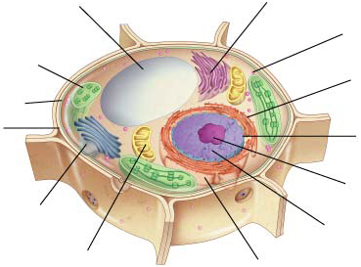
Cell Overview Cell Structures
Vacuole
Smooth endoplasmic
reticulum
Ribosome
(free)
Chloroplast
Ribosome
(attached)
Cell
Membrane
Nuclear
envelope
Cell wall
Nucleolus
Golgi apparatus
Nucleus
Mitochondrion
Rough endoplasmic reticulum

Slide 9
Plant Cell: Nucleus
Nucleus
STRUCTURE
DNA
Chromatin
Chromosomes
Nucleolus
Nuclear envelope
FUNCTION
Contains coded instructions for making proteins & molecules.

Slide 10
Plant Cell: Nucleolus
Nucleolus
STRUCTURE
Dense region
Inside nucleus
FUNCTION
Assembles ribosomes

Slide 11
Plant Cell: Nuclear Envelope
Nuclear envelope
STRUCTURE
Many nuclear pores
Two membranes
FUNCTION
Regulates entry and exit from nucleus for molecules …
Proteins
RNA
Other molecules.

Slide 12
Understanding ✓ #1
Many people have the capability of copying songs. If you loan a CD to a friend, would you loan the original or a copy?
Why doesn’t original DNA leave the nucleus?
You’d loan the copy because the original can always be used to produce high-quality copies.
The nucleus protects its original DNA and only allows copies to leave the cell.

Slide 13
Plant Cell: Cell Wall
Cell Wall
STRUCTURE
Lies outside the cell membrane
Porous to oxygen, carbon dioxide, and water
Made of carbohydrate and protein fibers
Made of cellulose
FUNCTION
Functions to support and protect the cell.

Slide 14
Plant Cell: Chloroplast
Chloroplast
STRUCTURE
Surrounded by two membranes
Chlorophyll are in large stacks called grana
FUNCTION
Capture energy from sunlight
Convert sunlight into chemical energy
Photosythesis!.

Slide 15
Plant Cell: ER (Smooth)
Endoplasmic reticulum (smooth)
STRUCTURE
Internal membrane system
Collection of specialized enzymes
FUNCTION
Assembles lipid components of the cell membrane
Drug detoxification (esp. liver).

Slide 16
Plant Cell: Ribosome (free)
Ribosome (free)
STRUCTURE
Found throughout cytoplasm
FUNCTION
Assembles proteins via nuclear instructions
Proteins that are produced remain inside the cytoplasm (not secreted).

Slide 17
Plant Cell: ER (rough) and Ribosome (attached)
STRUCTURE
Named “rough” because ribosomes on the surface
FUNCTION
It is involved in protein synthesis
Proteins from attached ribosomes are chemically modified by this
Protein export to cell membrane or secreted out of cell.
Ribosome (attached)
Endoplasmic reticulum (rough)

Slide 18
Plant Cell: Vacuole
Vacuole
STRUCTURE
One large central “sack” in plants filled with liquid
Contractile structure (paramecium) pumps excess water out of the cell to maintain homeostasis
FUNCTION
Stores materials
Digestive enzymes
Water
Salts
Proteins
Carbohydrates
Internal pressure holds leaves and flowers rigid (plants).

Slide 19
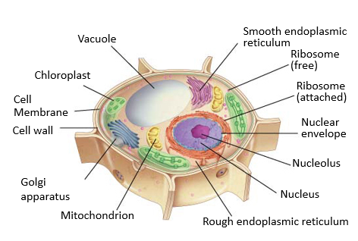
Checkpoint 1
Identify each plant cell organelle by function for its Friday’s exam.

Slide 20
Checkpoint 2 Plant Cell Structures
Vacuole
Smooth endoplasmic
reticulum
Ribosome
(free)
Chloroplast
Ribosome
(attached)
Cell
Membrane
Nuclear
envelope
Cell wall
Nucleolus
Golgi apparatus
Nucleus
Mitochondrion
Rough endoplasmic reticulum

Slide 21
Check
point 2
Identify each plant cell organelle by structure for Friday’s exam.

Slide 22
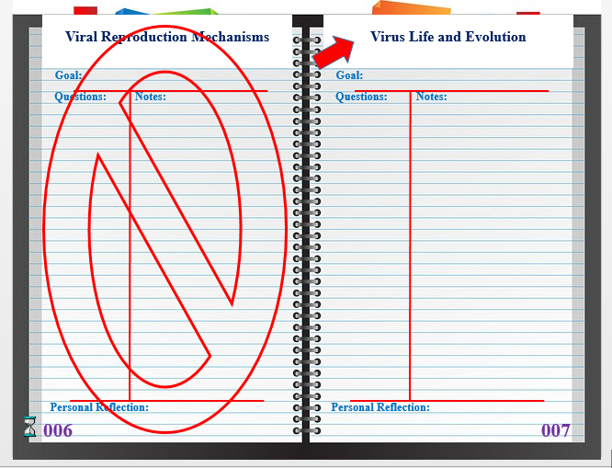
Checkpoint 3 Interactive Notebook
Good Job!
Independently complete your personal reflection and notebook big idea page.

Slide 23
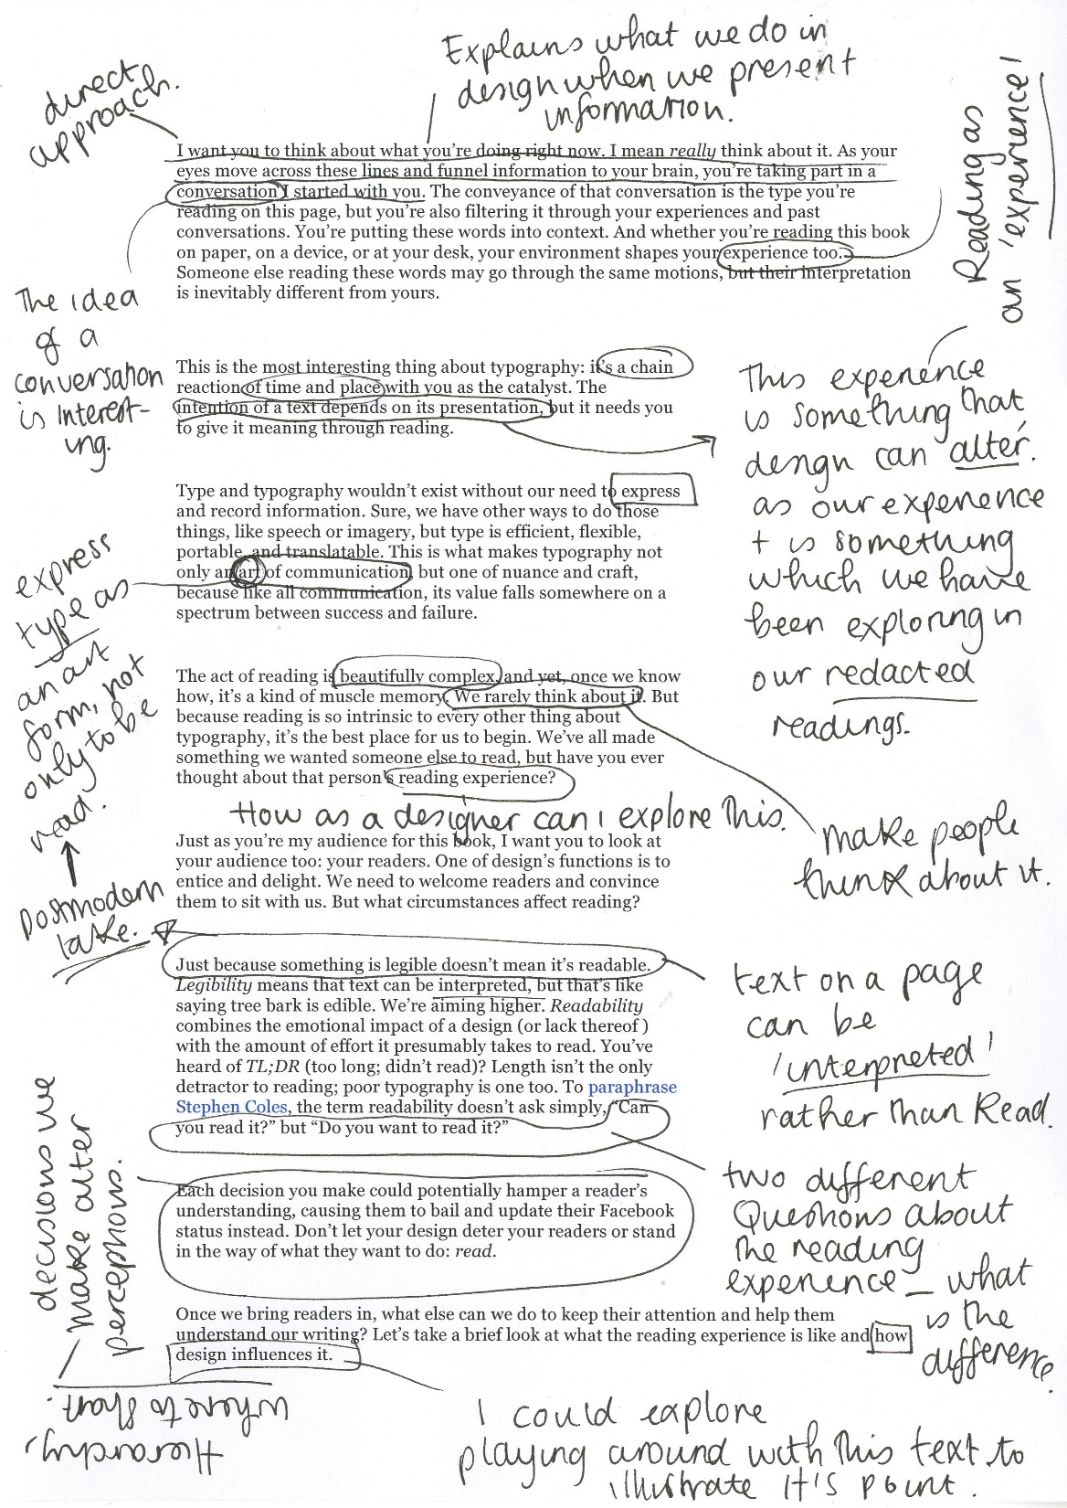

Conditions for Success
Markup the Article to Identify Claim and Evidence (Data)
Annotate the Article with warrants based on data relating to claims and counterclaims.
Create a persuasive essay in your notebook that evaluates the validity of the claim.
Due Today
Be sure to markup and annotate the text & compose your persuasive essays in your notebooks.

Slide 24
Evidence That You Have Successfully Completed This Lesson
Checkpoints
Good Job!
Contextualize the graphical notes in preparation for Friday’s exam.
Complete video notes for the purpose of analyzing zoonotical viral evolution.
Independently complete your personal reflection and notebook big idea page.

Slide 25
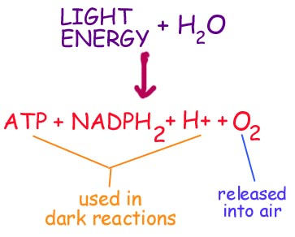
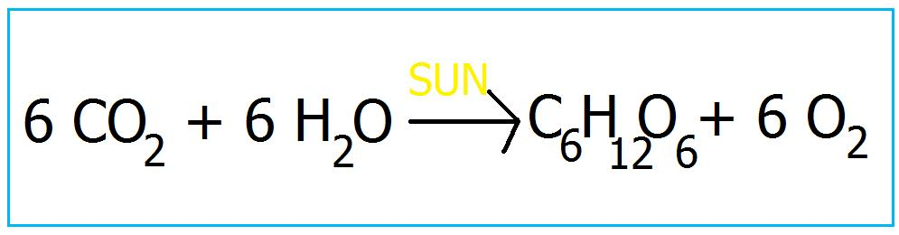
Mitochondria
Due
Today
Time Check

